Slide 1


Building a sustainable business model with your community
Sylvain Le Bon

Slide 2
A business model for free software?
How can we make free software sustainable?
  Free software provide a lot of value to the community
  How can we monetize that value to fund developments in a sustainable way?

Slide 3
Open source is an efficient model
Because collaboration is efficient!
    Don't reinvent the wheel
    Get external contributions
    You don't have to know everything

Slide 4

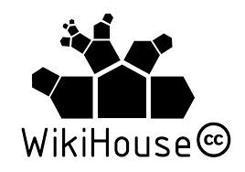

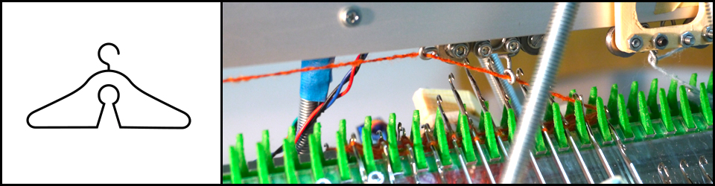




Open source success beyond software
OpenKnit

Slide 5

Looking for a business model ?
Taking care of other people's needs takes time.
A lot of time...

Slide 6

Need for sustainability
How do we deal with the « new father syndrom »?

Slide 7
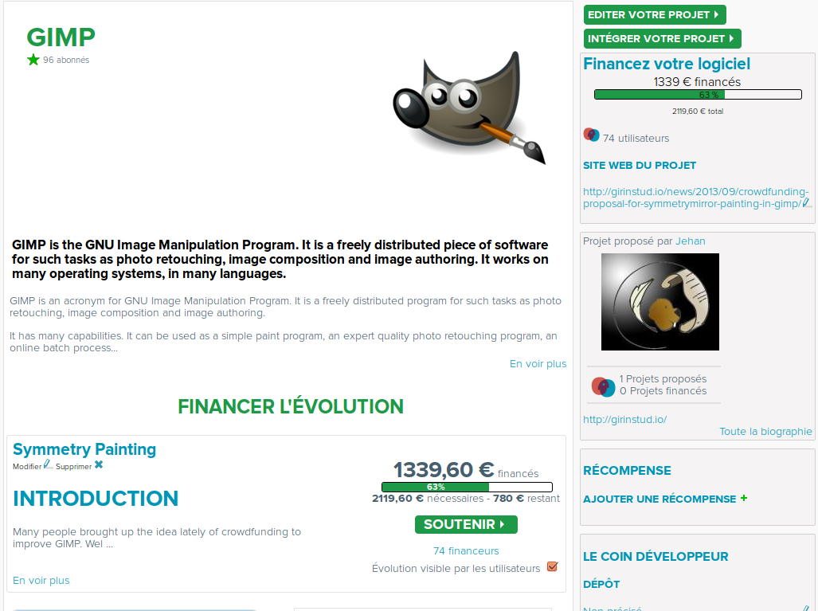
Open Funding

Slide 8
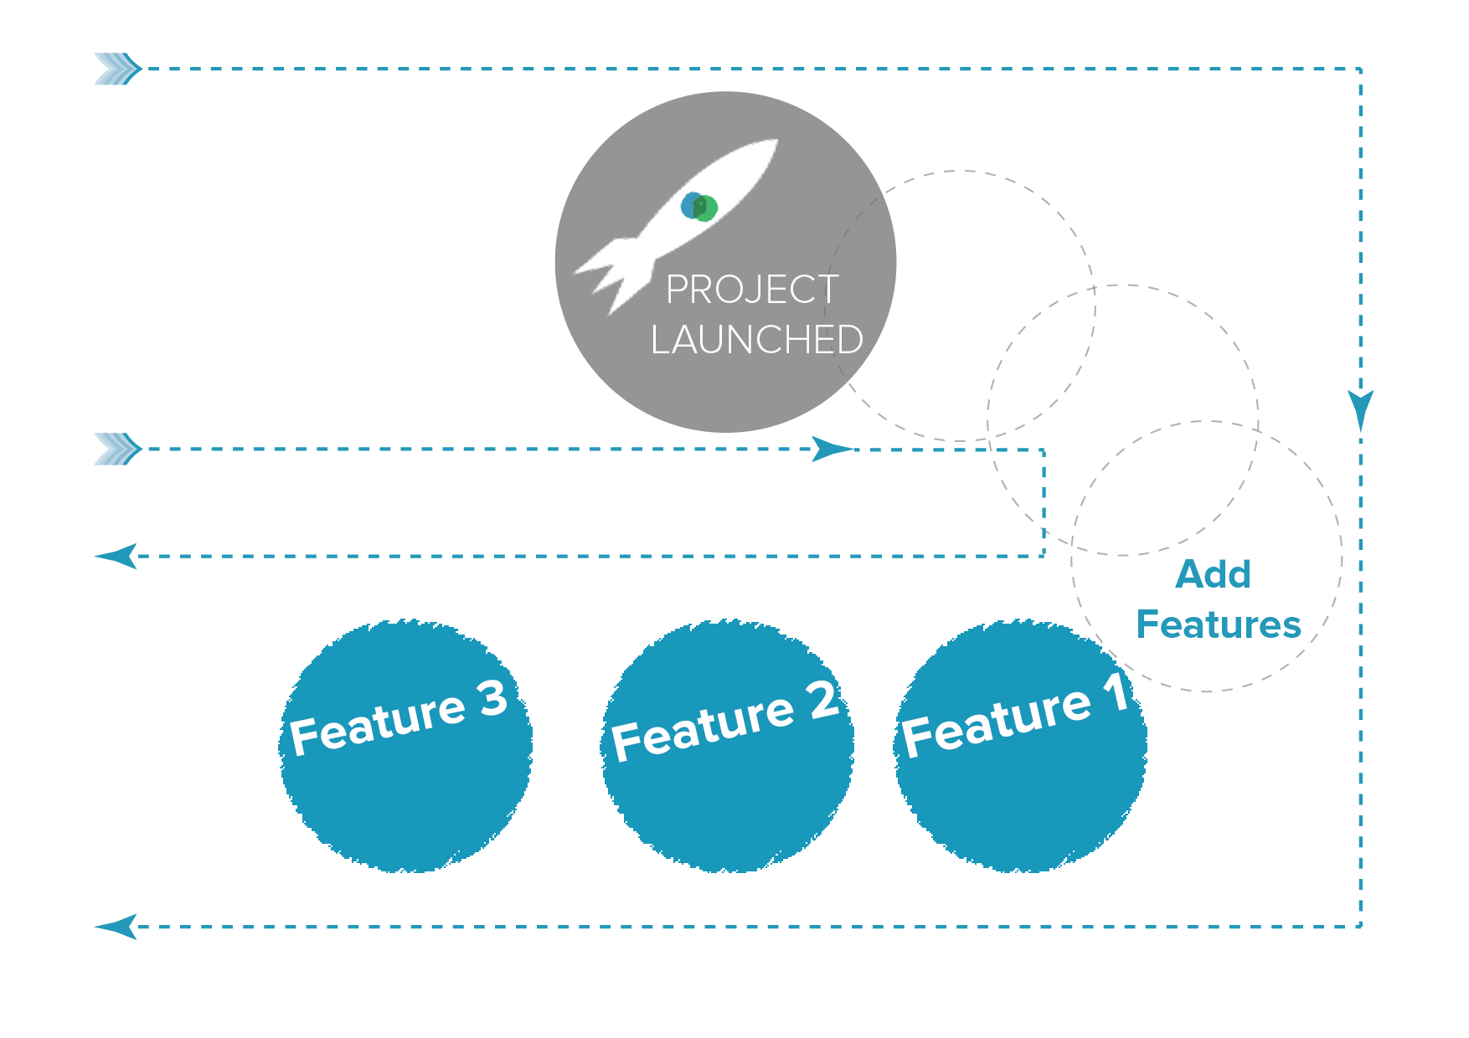
The developer offers new features

Slide 9
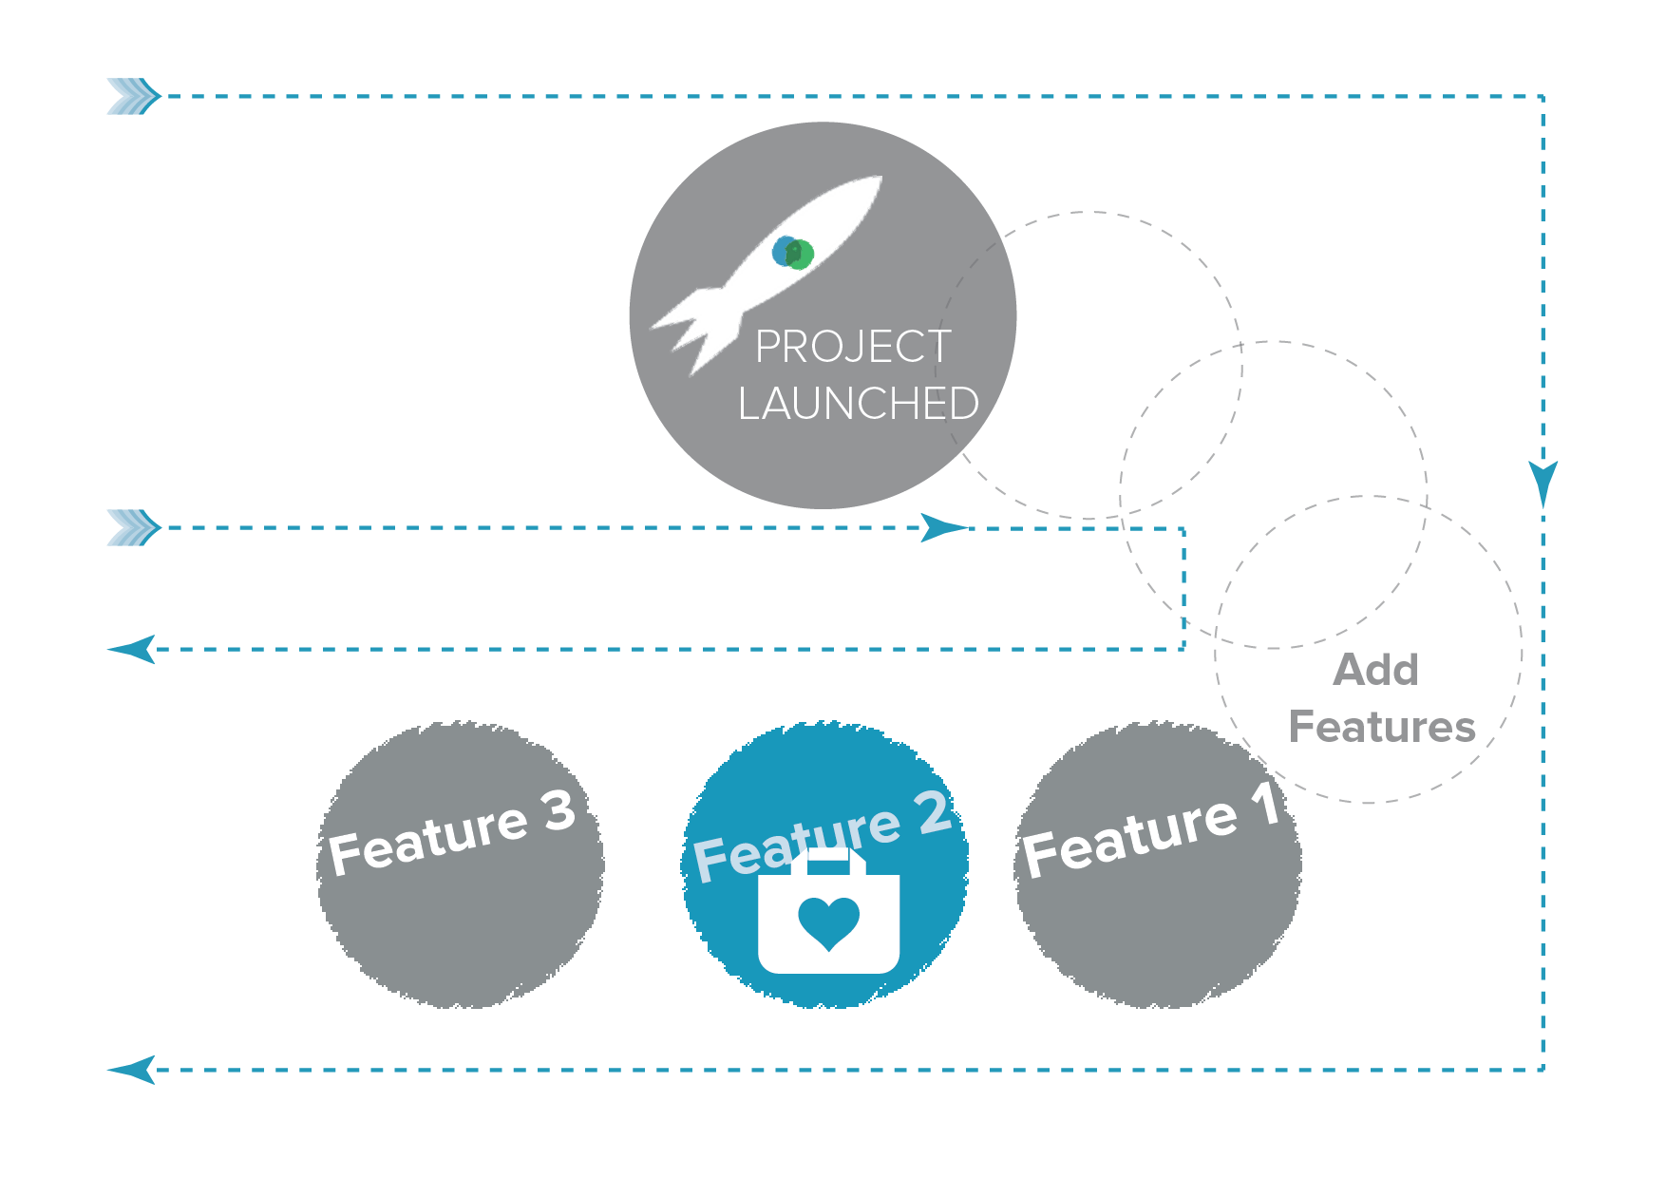
You buy the features you need

Slide 10
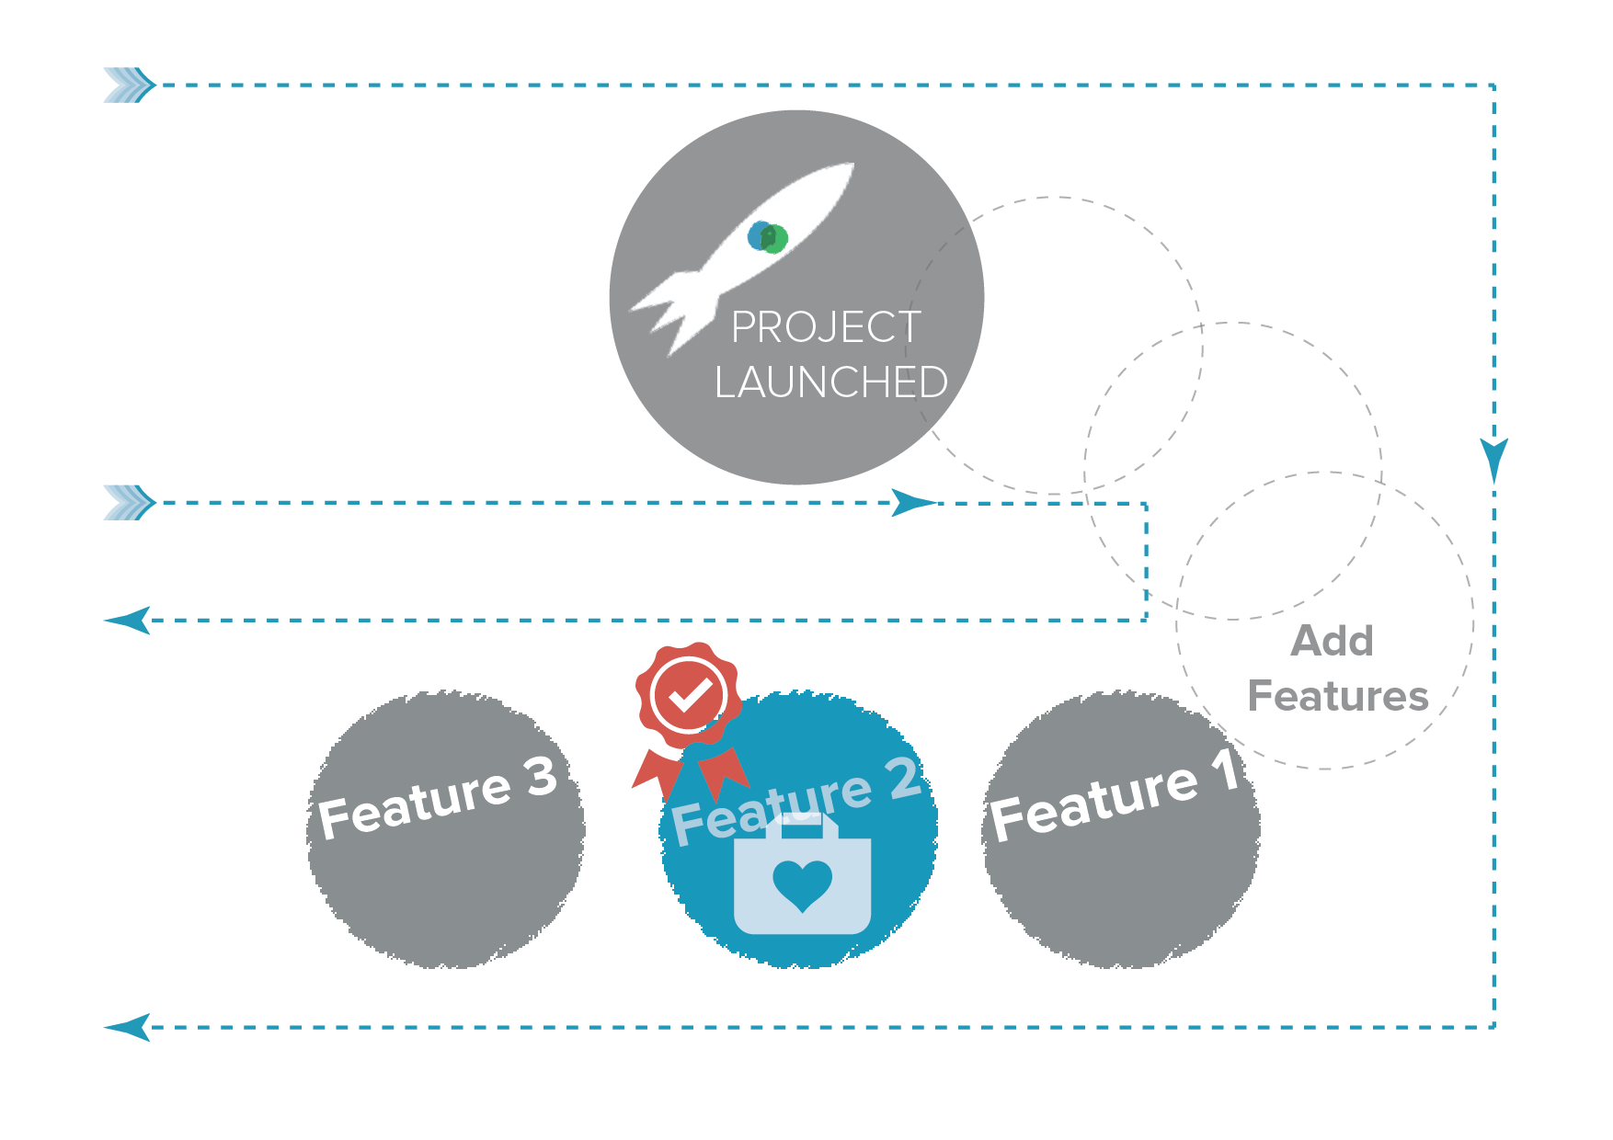
You validate the results

Slide 11
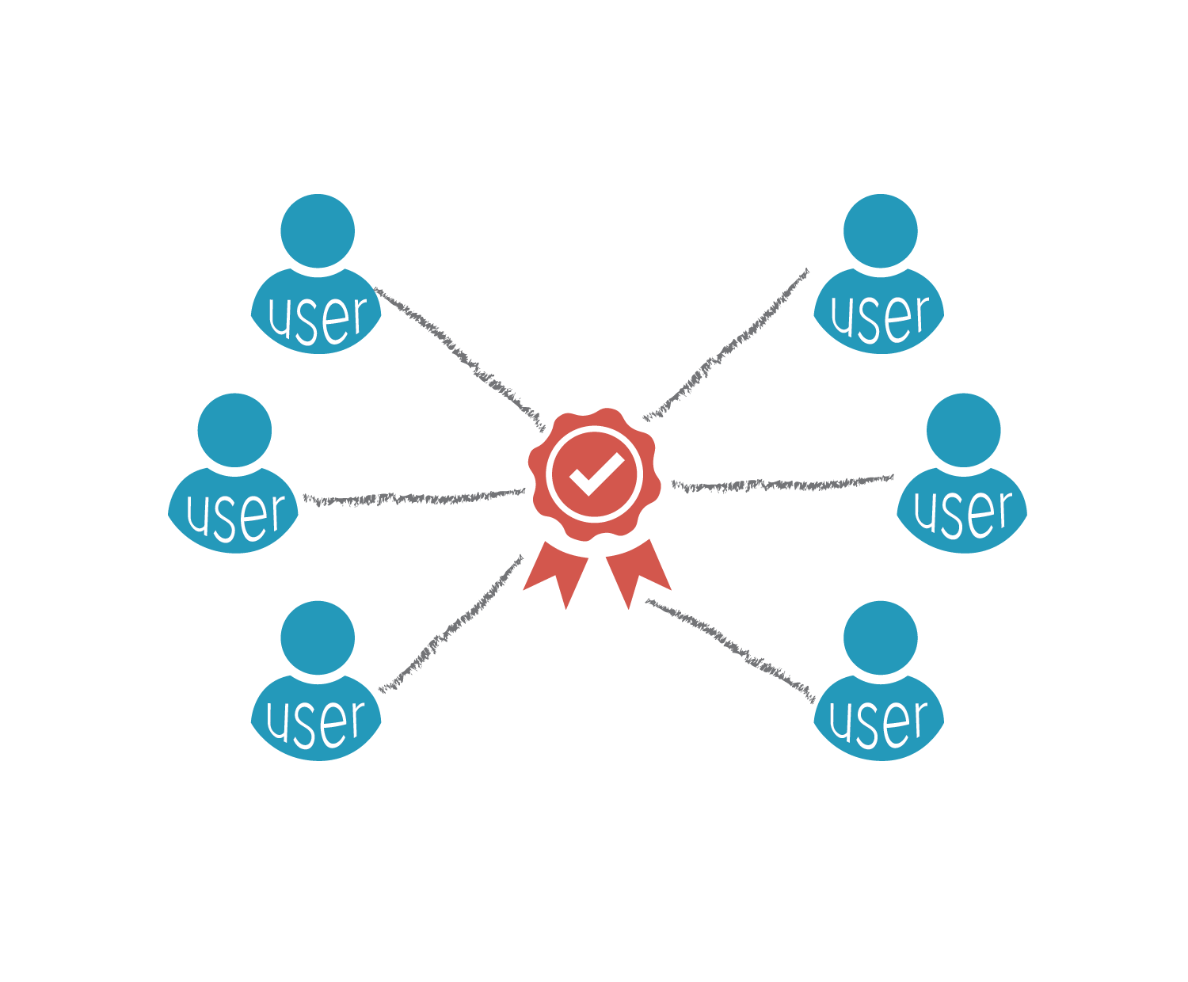
Mutualizing professional quality

Slide 12

Shared costs

Slide 13
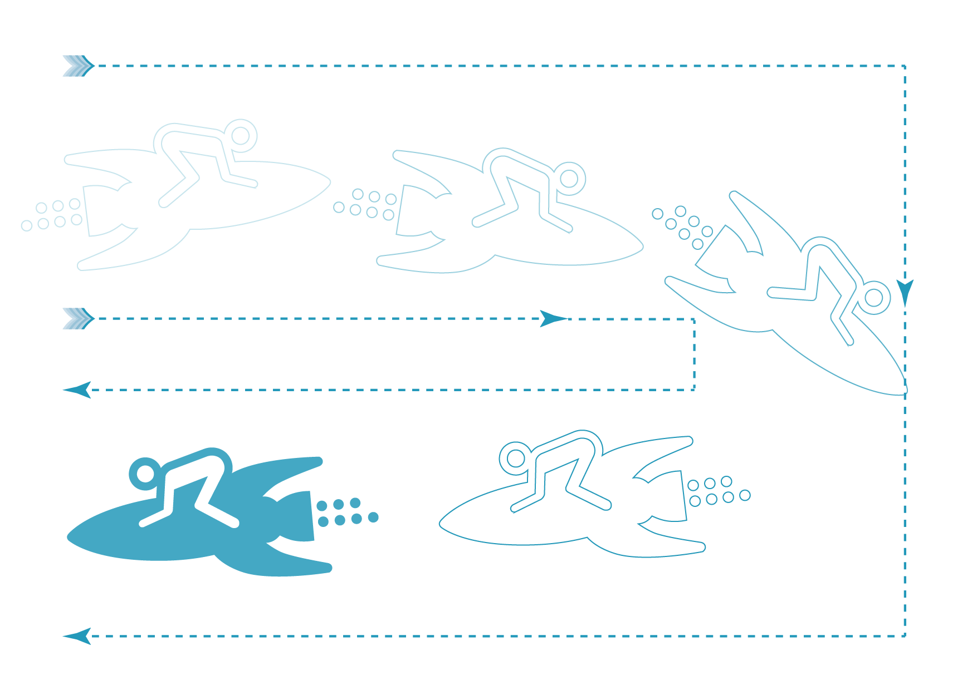
Acceleration of projects

Slide 14
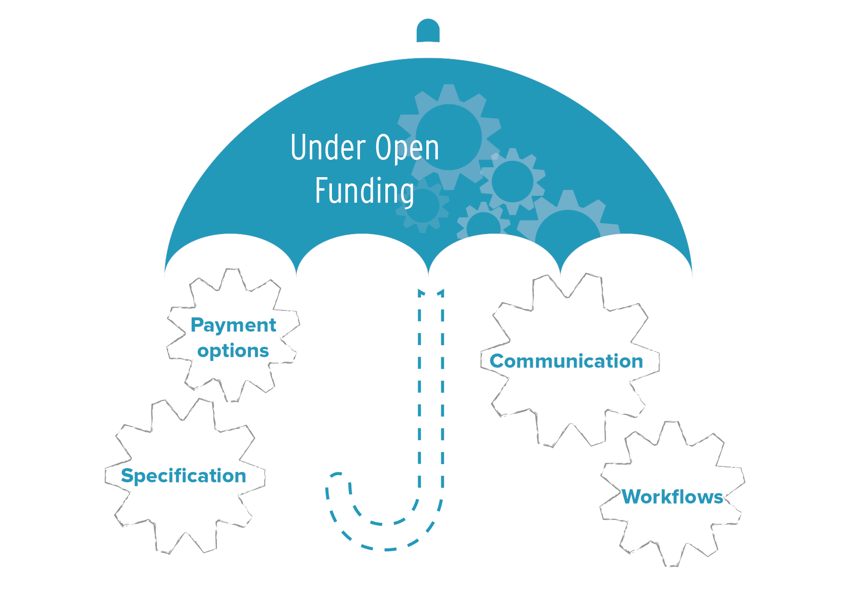
Choose the right tools

Slide 15
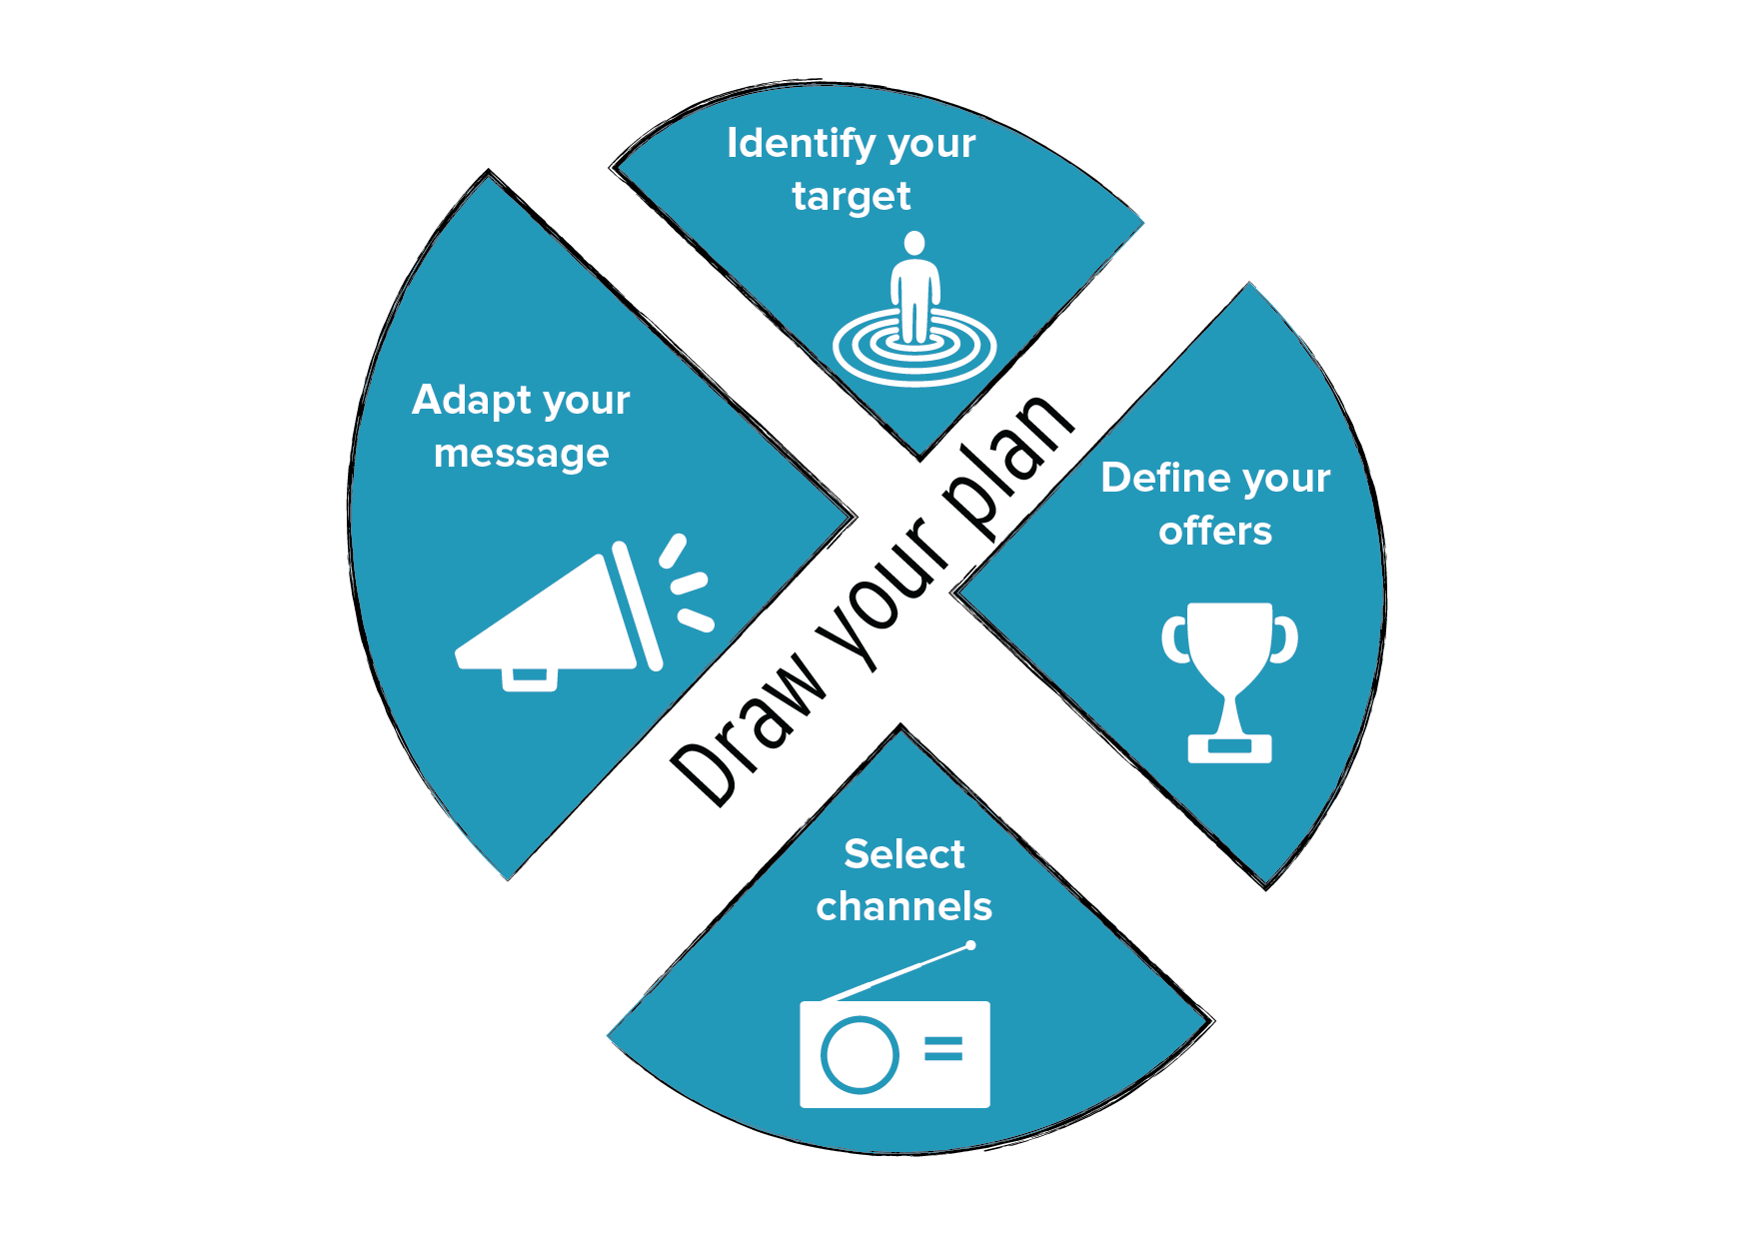
Define the strategy

Slide 16
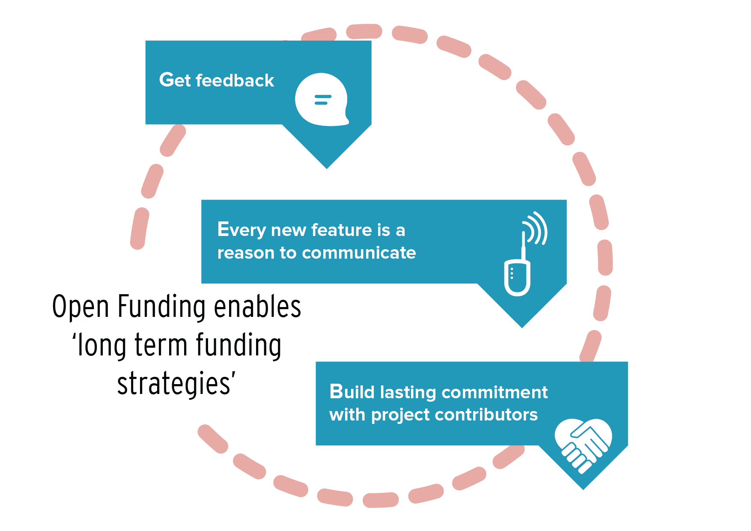
Long term vision

Slide 17
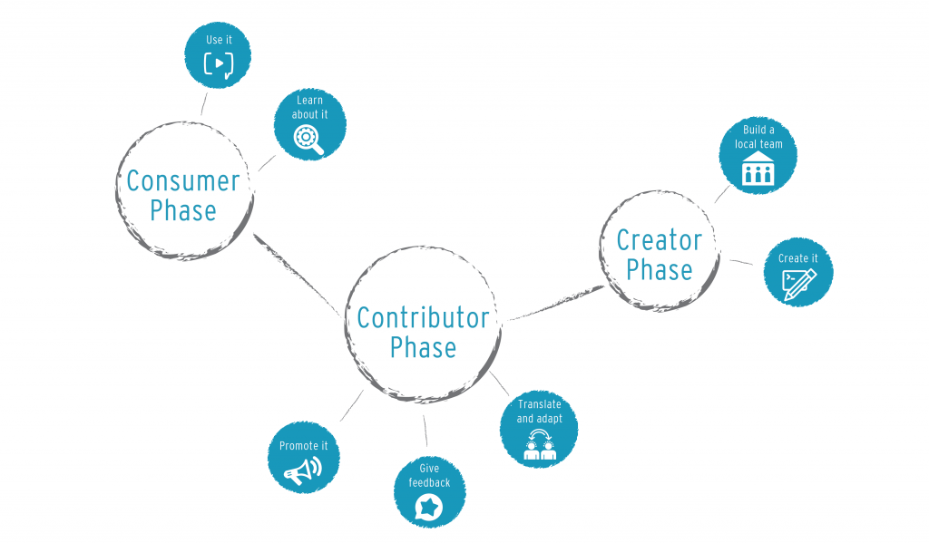
Community involvement
Think of
Choice-supportive bias !

Slide 18
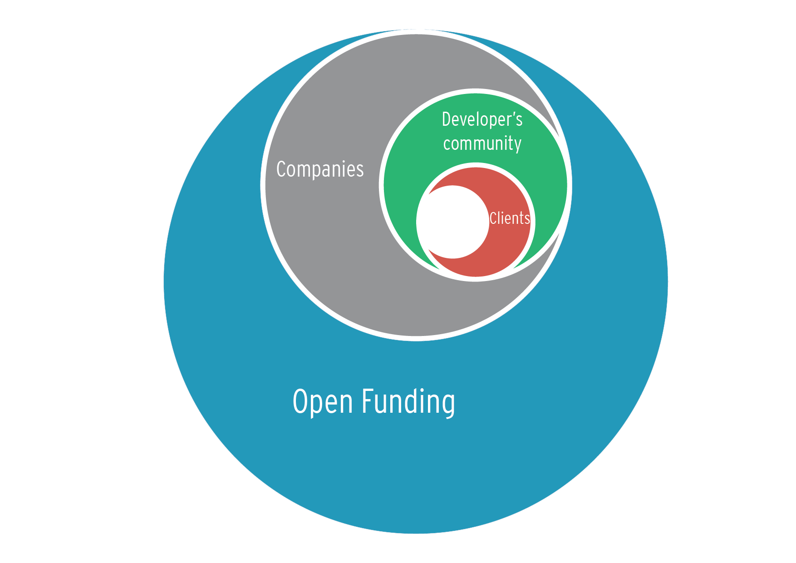
Build your ecosystem
Fund 3rd party developers
Get funding through the ecosystem
Make your ecosystem stronger

Slide 19
Community involvement
Understand people's needs
Build your roadmap, your funding plan and your communication together
Get your software more sustainable!

Slide 20
Cofunding free software
Contact
Sylvain Le Bon
http://funding.openinitiative.com/
contact@openinitiative.com

